Slide 1
Le Art Exam

Slide 2
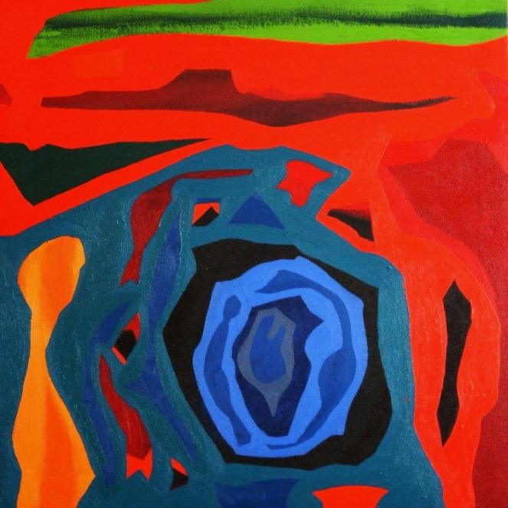
Crystal
'The Loyalist'
2003
oil on canvas
60cm x 60cm
Crystal
Acrylic on Wood Board?
September 2011

Slide 3
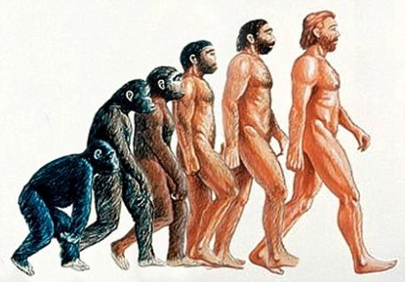
Alex Weis Coexistence Clay and Glass sculpture October 2011
Religion-Mainly Christianity
Vs.
Scientific Theory

Slide 4
Monster
Acrylic on Canvas
December 2011
Imogen
Spray Paint on Concrete
2010

Slide 5
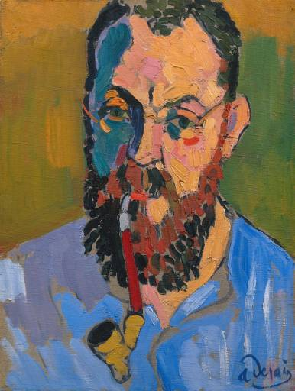
"The Houses of Parliament, London"
Oil on Canvas, 1904 Size 31 x 36" (81 x 92 cm)
Pride
Acrylic on Canvas
October 2011

Slide 6
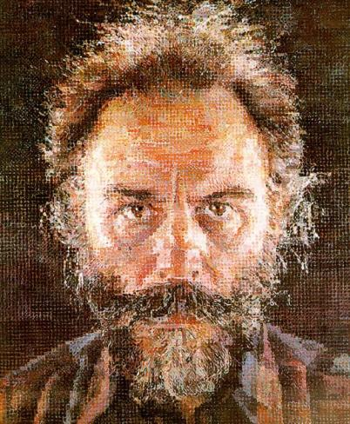
Lucas Chuck Close 1987
The Big Self Portrait
Chuck Close
Wolf
Acrylic on Canvas
February 2012

Slide 7
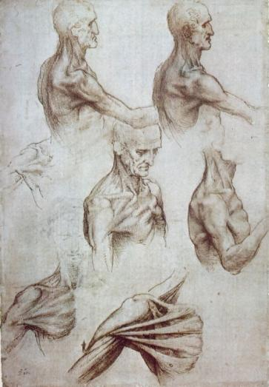
Pulse
Acrylic on Canvas
March 2012
Muscles of the Neck and Shoulders c. 1515
Anatomical Study of Larynx and Leg 1510

Slide 8
Bird Woman.
oil on linen.
36 x 48 inches.
May - July 2003
Perfect in Death
Ink on paper
November 2011

Slide 9
Perfect in Death
Oil paint on paper
December 2011
Queen and her pet. Oil on canvas, 46 x 55 inches. Spring to Summer 1997

Slide 10
Things That Are Stacked
Plaster sculpture
April 2012
James Nizam
Memorandom
2012

